Slide 1

AI Investment Advisor
Personalized Financial Guidance Powered by GenAI

Slide 2

Closing the Advisory Gap
Democratizing access to high-quality wealth management through intelligent automation.

Slide 3

Barriers in Traditional Advice
High Entry Costs
Human Bias & Delay
Traditional wealth management often requires high minimum balances, excluding 80% of potential retail investors.
Human advisors are subject to cognitive biases and limited bandwidth, resulting in delayed market responses.

Slide 4

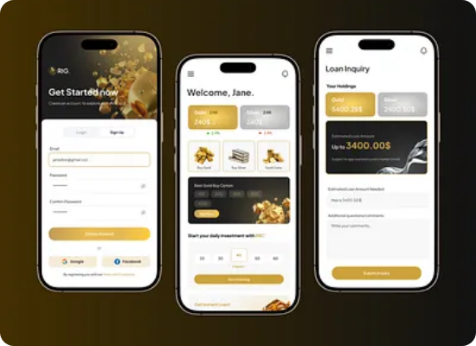
The Solution: Intelligence at Scale
Dynamic Profiling: Real-time assessment of risk appetite and life goals.
Instant Analysis: Generating portfolio recommendations in under 5 seconds.
Agentic Search: Real-time integration with global market indices and news.

Slide 5





Technical Architecture Pillars
RAG Engine
AI Agents
Responsible AI
Retrieval Augmented Generation ensures data accuracy using verified financial reports.
Autonomous agents fetch live market data from APIs to inform model reasoning.
Built-in compliance filters ensure all advice follows financial regulations.

Slide 6
Performance and Efficiency
94%
10x
-70%
ACCURACY RATE
FASTER DELIVERY
OPERATIONAL COST

Slide 7
Competitive Landscape Analysis
Feature | Traditional Advisor | Standard Robo | AI Advisor (Ours)
24/7 Availability
Contextual Reasoning
Real-time Rebalancing

Slide 8
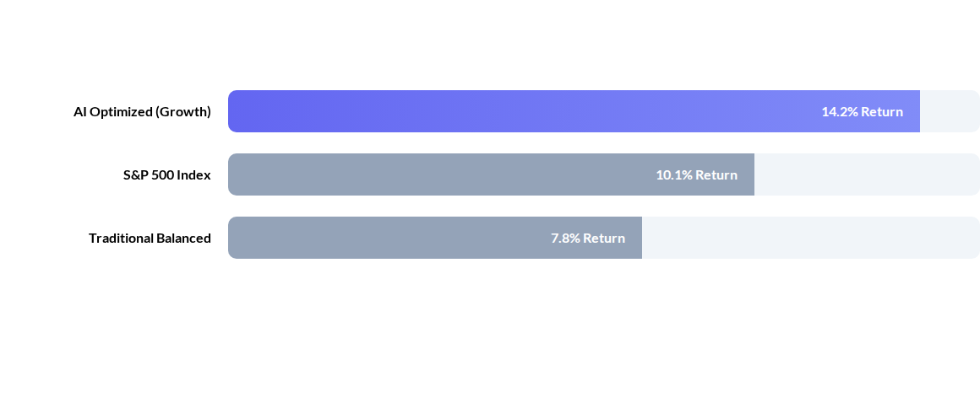
Portfolio Performance Simulation
Simulated back-testing over a 5-year period showing superior risk-adjusted returns.

Slide 9
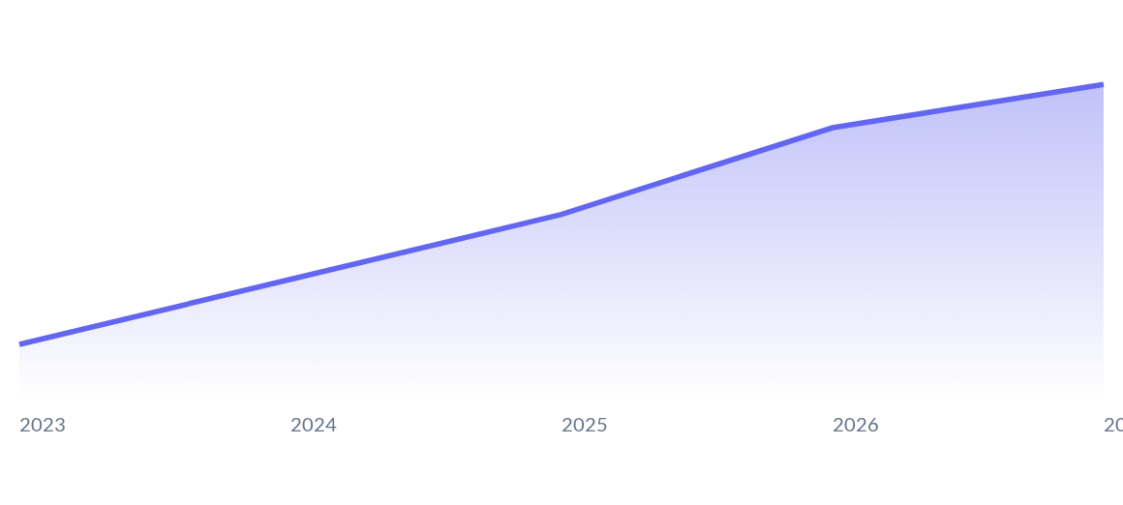
Rising Consumer Trust in AI
Consumer adoption of AI financial tools is projected to grow 3x by 2027.

Slide 10
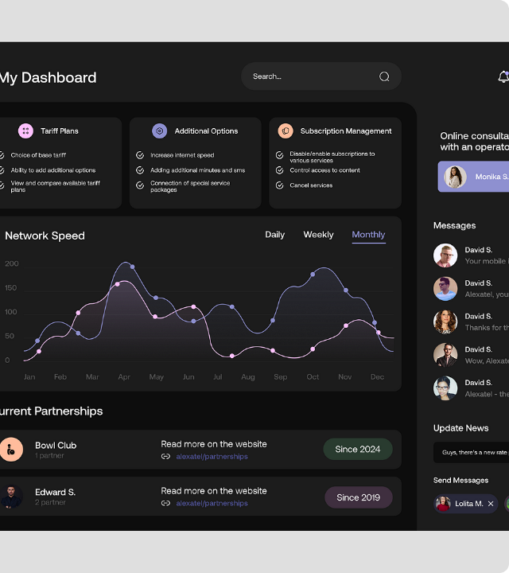
The "What-If" Analysis
A core differentiator allowing users to stress-test their portfolios against historical and hypothetical market scenarios instantly.
Adjust variables like inflation, interest rates, and sector crashes to see immediate impact projections.

Slide 11
Phased Implementation Roadmap
Phase 1
Phase 2
Phase 3
Phase 4
Prototype & Core RAG Integration
Agentic Market Data Pipeline
Beta Launch & Compliance Audit
Full Public Deployment

Slide 12

Thank You
Questions and Discussion
www.ai-advisor-demo.com

Slide 13




Image Sources
https://cdn.dribbble.com/userupload/46985469/file/0b8fe927c3b868e58f828bad9c2e32bf.png?format=webp&resize=400x300&vertical=center
Source: dribbble.com
https://miro.medium.com/v2/resize:fit:1400/0*8o2T4T-H4gKFQ9yT
Source: medium.muz.li
https://png.pngtree.com/thumb_back/fw800/background/20251231/pngtree-futuristic-network-connections-in-dark-space-image_20964452.webp
Source: pngtree.com
https://digitalworkplacegroup.com/wp-content/uploads/2025/06/digital-transformation-technology.jpg
Source: digitalworkplacegroup.com

